Slide 1
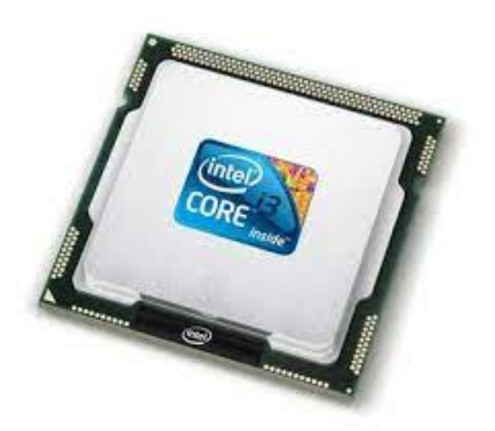
Unit 4.1 - Processor Fundamentals
Prepared by: Koh Kian Hua

Slide 2
Objectives (Part 2)
After completing this unit, students should be able to:
Describe the stages of the Fetch-Execute (F-E) cycle and how the ‘register transfer’ notation can be used to describe the F–E cycle.
Show understanding of the purpose of interrupts in possible causes and applications of interrupts,.
Show understanding of the use of an Interrupt service (ISR) handling routine, when interrupts are detected during the fetch execute cycle and how interrupts are handled.

Slide 3
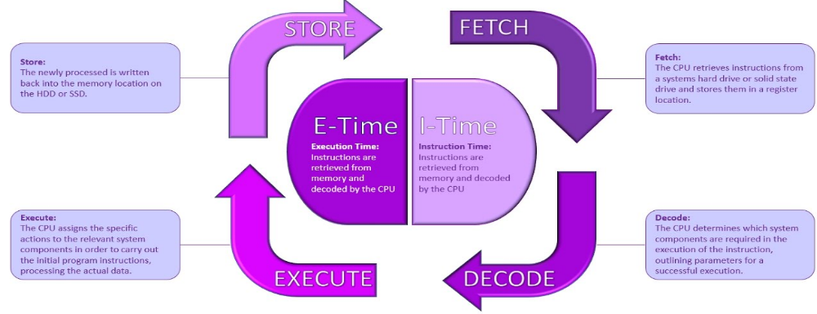
Central Processing Unit
Fetch-execute cycle
To executive an instruction, the CPU fetches the instructions one at a time from the main memory into the registers. One register is the program counter (pc).
The CPU decodes the instruction.
The CPU executes the instruction.
Repeat until there are no more instructions

Slide 4
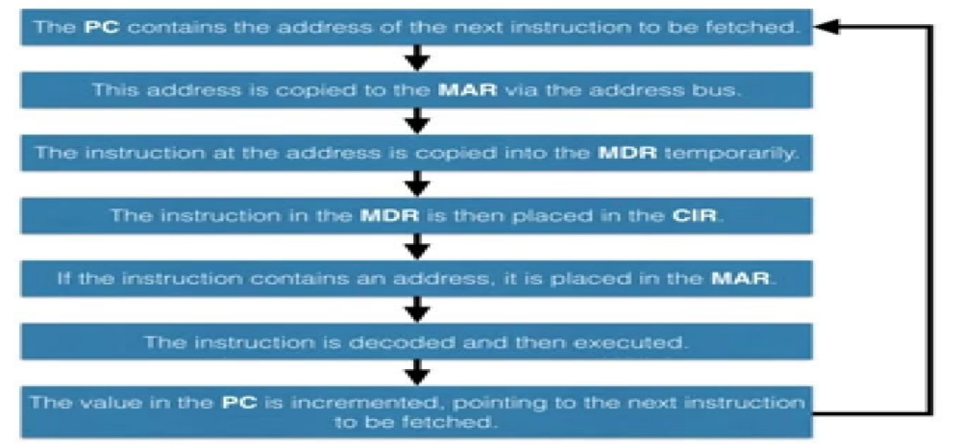
Central Processing Unit
Fetch-execute cycle
Diagram showning the FE cycle including the use of registers

Slide 5
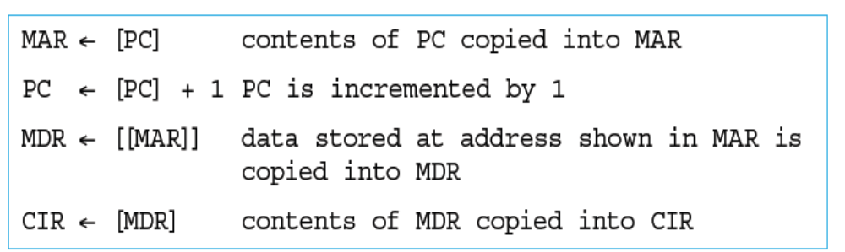
Central Processing Unit
Fetch-execute cycle
In a Fetch-Execute cycle involving registers, it is possible to represent it using Register Transfer Notation (RTN)
Double brackets are used in the third line to denote it is not MAR contents being copied into MDR but it is the data stored at the address shown in MAR that is being copied to MDR.

Slide 6
Central Processing Unit
Interrupts
An interrupt is a signal sent from a device or from software to the processor. This will cause the processor to temporarily stop what it is doing and service the interrupt.
Interrupts can be caused by, for example:
a timing signal
input/output processes (a disk drive is ready to receive more data)
a hardware fault (an error has occurred such as a paper jam in a printer)
user interaction (the user pressed a key to interrupt the current process, such as <CTRL><ALT><BREAK>)
a software error that cannot be ignored (if an .exe file could not be found to initiate the execution of a program OR an attempt to divide by zero)

Slide 7
Central Processing Unit
Fetch-execute cycle with interrupts
A special register called the interrupt register is used in the fetch-execute cycle. The Interrupt Process of a Fetch Executive cycle is shown below:
At the next fetch-execute cycle, the interrupt register is checked bit by bit.
If an interrupt occurred during a previous cycle, the CPU would now service this interrupt or ignore it for now, depending on its priority.
Once the interrupt is serviced by the CPU, it stops its current task and stores the contents of its registers.
Control is now transferred to the interrupt handler (or interrupt service routine, ISR).
Once the interrupt is fully serviced, the register is reset and the contents of registers are restored.

Slide 8
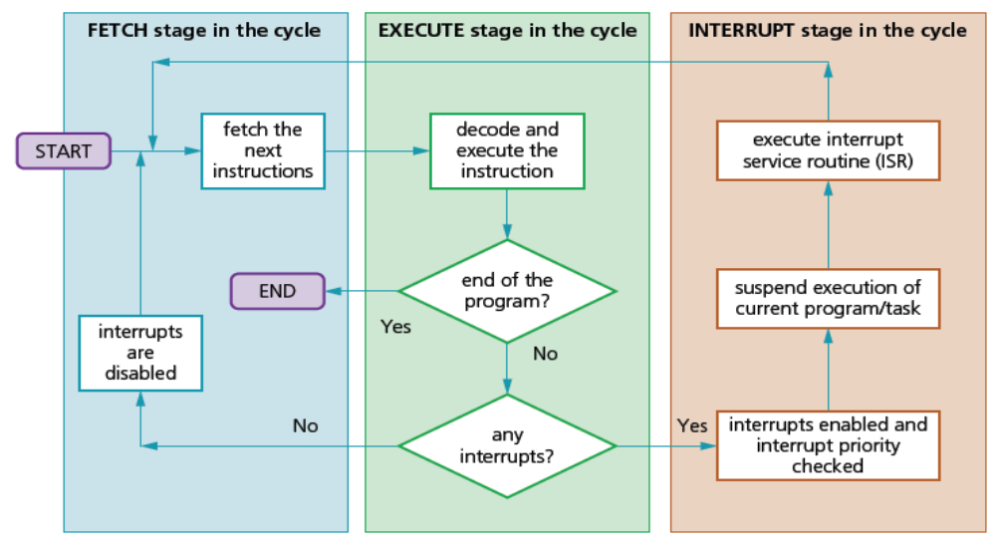
Central Processing Unit
Fetch-execute cycle with interrupts
Diagram showing the interrupt process during a Fetch-Execute (FE) cycle

Slide 9
Central Processing Unit
Fetch-execute cycle with interrupts
A special register called the interrupt register is used in the fetch-execute cycle. The Interrupt Process of a Fetch Executive cycle is shown below:
At the next fetch-execute cycle, the interrupt register is checked bit by bit.
If an interrupt occurred during a previous cycle, the CPU would now service this interrupt or ignore it for now, depending on its priority.
Once the interrupt is serviced by the CPU, it stops its current task and stores the contents of its registers.
Control is now transferred to the interrupt handler (or interrupt service routine, ISR).
Once the interrupt is fully serviced, the register is reset and the contents of registers are restored.

Slide 10
Central Processing Unit
Class Activity
1. What are the 3 stages of a fetch-execute cycle ?
2. What registers are used in fetch?

